Slide 1
Mass Storage Structure Lesson 2 HDD Scheduling
David Liu
Fall 2021, Spring 2022

Slide 2
HDD Scheduling
The operating system is responsible for using hardware efficiently — for the disk drives, this means having a fast access time and disk bandwidth
Minimize seek time
Seek time ≈ seek distance
Disk bandwidth is the total number of bytes transferred, divided by the total time between the first request for service and the completion of the last transfer

Slide 3
Disk Scheduling (Cont.)
There are many sources of disk I/O request
OS
System processes
Users processes
I/O request includes input or output mode, disk address, memory address, number of sectors to transfer
OS maintains queue of requests, per disk or device
Idle disk can immediately work on I/O request, busy disk means work must queue
Optimization algorithms only make sense when a queue exists
In the past, operating system responsible for queue management, disk drive head scheduling
Now, built into the storage devices, controllers
Just provide LBAs (Logical block addresses), handle sorting of requests
Some of the algorithms they use described next

Slide 4
Disk Scheduling (Cont.)
Note that drive controllers have small buffers and can manage a queue of I/O requests (of varying “depth”)
Several algorithms exist to schedule the servicing of disk I/O requests
The analysis is true for one or many platters
We illustrate scheduling algorithms with a request queue (0-199)
98, 183, 37, 122, 14, 124, 65, 67 (cylinders)
Head pointer 53

Slide 5
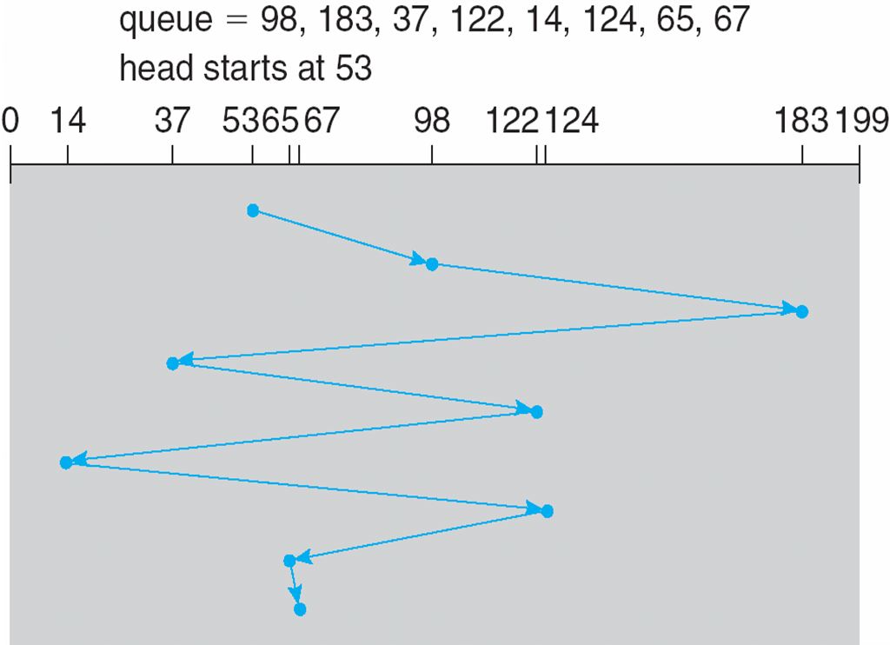
FCFS
Illustration shows total head movement of 640 cylinders

Slide 6
SCAN
The disk arm starts at one end of the disk, and moves toward the other end, servicing requests until it gets to the other end of the disk, where the head movement is reversed and servicing continues.
SCAN algorithm Sometimes called the elevator algorithm
Illustration shows total head movement of 208 cylinders
But note that if requests are uniformly dense, largest density at other end of disk and those wait the longest

Slide 7
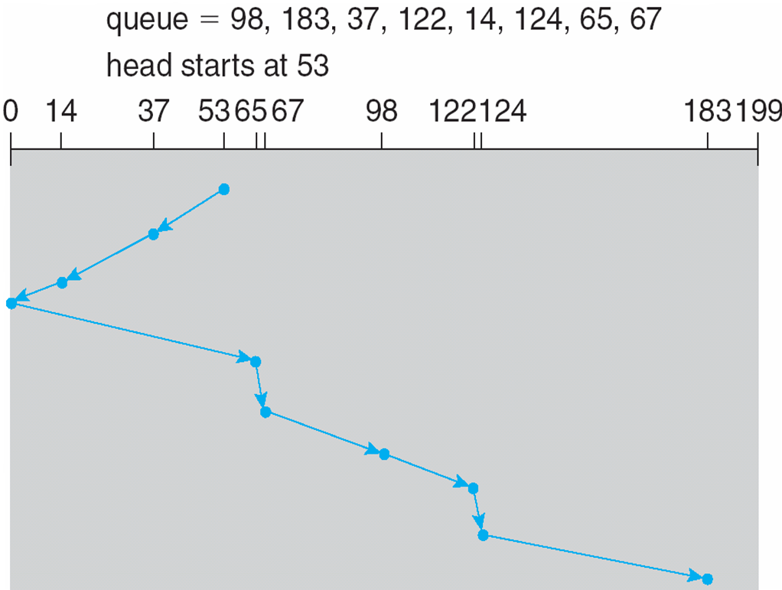
SCAN (Cont.)
Illustration shows total head movement of 208 cylinders
Move down

Slide 8
C-SCAN
Provides a more uniform wait time than SCAN
The head moves from one end of the disk to the other, servicing requests as it goes
When it reaches the other end, however, it immediately returns to the beginning of the disk, without servicing any requests on the return trip
Treats the cylinders as a circular list that wraps around from the last cylinder to the first one
Total number of cylinders?

Slide 9
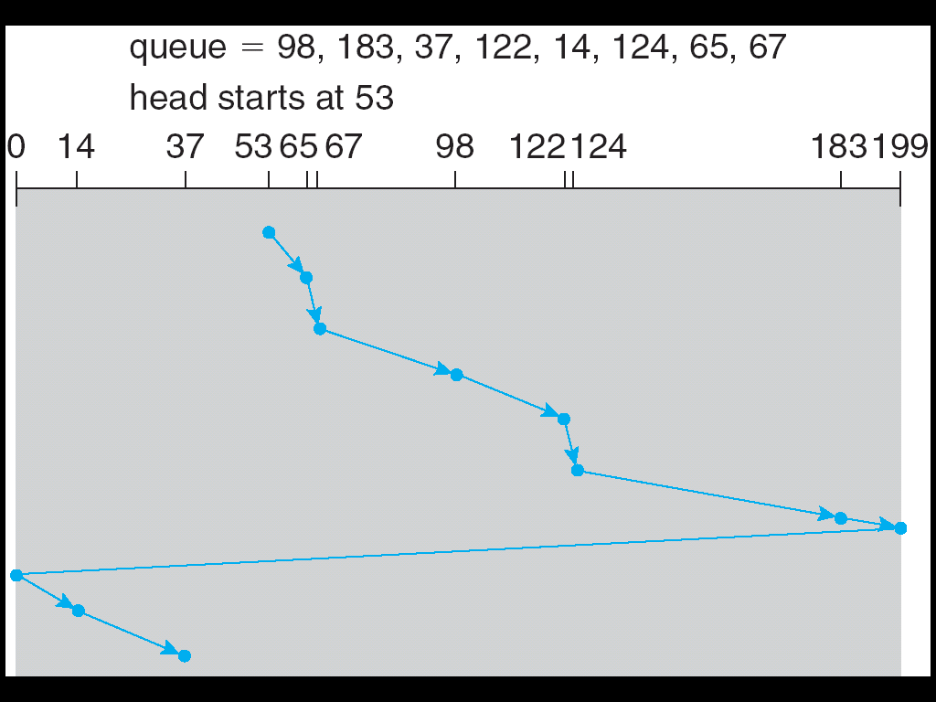
C-SCAN (Cont.)
Illustration shows total head movement of 199-53 + 37-0 = 183 cylinders
Move up

Slide 10
Selecting a Disk-Scheduling Algorithm
SCAN and C-SCAN perform better for systems that place a heavy load on the disk
Less starvation, but still possible
To avoid starvation Linux implements deadline scheduler
Maintains separate read and write queues, gives read priority
Because processes more likely to block on read than write
Implements four queues: 2 x read and 2 x write
1 read and 1 write queue sorted in LBA order, essentially implementing C-SCAN
1 read and 1 write queue sorted in FCFS order
All I/O requests sent in batch sorted in that queue’s order
After each batch, checks if any requests in FCFS older than configured age (default 500ms)
If so, LBA queue containing that request is selected for next batch of I/O
In RHEL 7 also
NOOP preferred for CPU-bounded systems using fast storage (NVM devices
completely fair queueing scheduler (CFQ), default for SATA devices

Slide 11
NVM Scheduling
No disk heads or rotational latency but still room for optimization
In RHEL 7 NOOP (no scheduling) is used but adjacent LBA requests are combined
NVM best at random I/O, HDD at sequential
Throughput can be similar
Input/Output operations per second (IOPS) much higher with NVM (hundreds of thousands vs hundreds)
But write amplification (one write, causing garbage collection and many read/writes) can decrease the performance advantage

